Slide 1
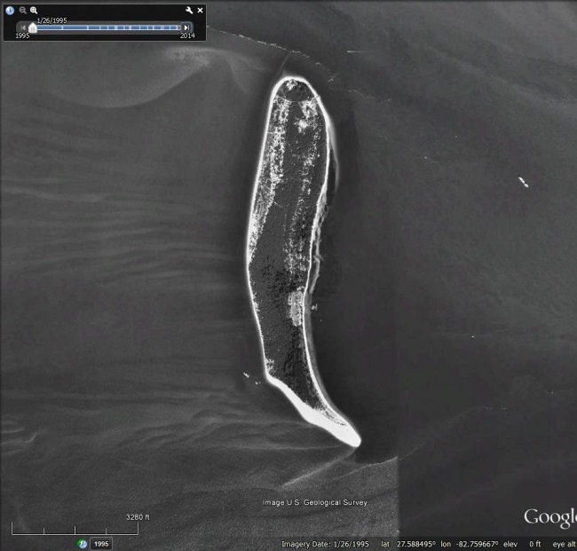
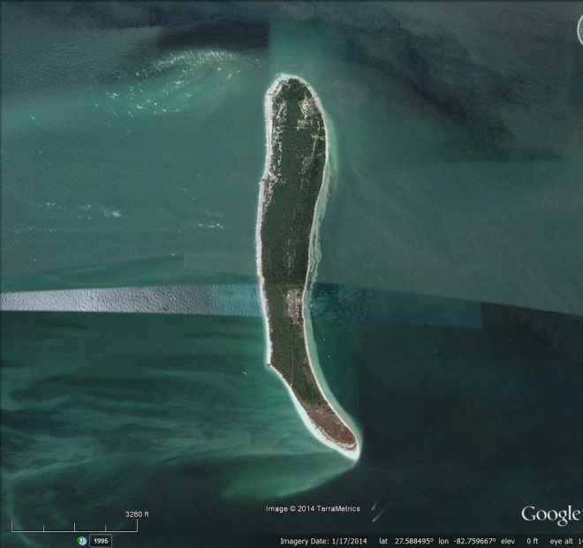
Rising Seas:
Florida’s Vulnerable Coastal Birds and Habitats
Egmont Key
1995
2014
Audubon FLORIDA

Slide 2
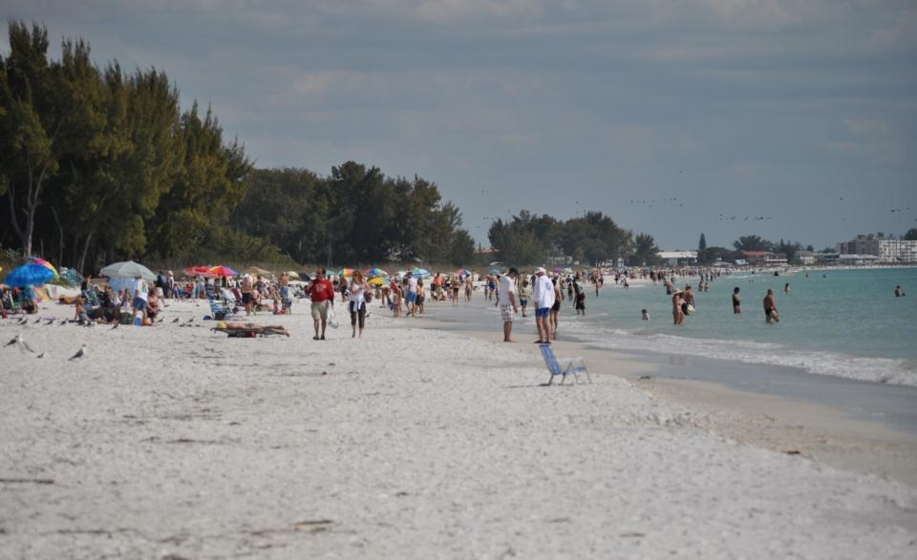
Florida’s coastal beaches are prized by millions of people…

Slide 3
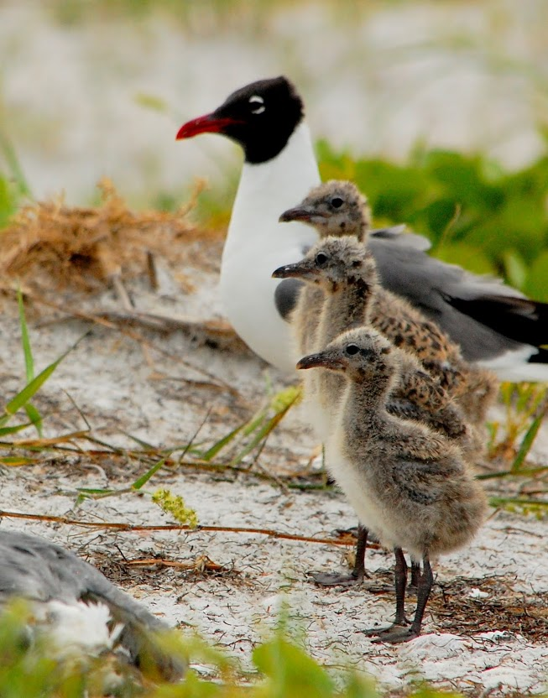
… but our coastlines are irreplaceable habitat for birds, sea turtles, and other wildlife.
Photo credit: Tom Carey

Slide 4
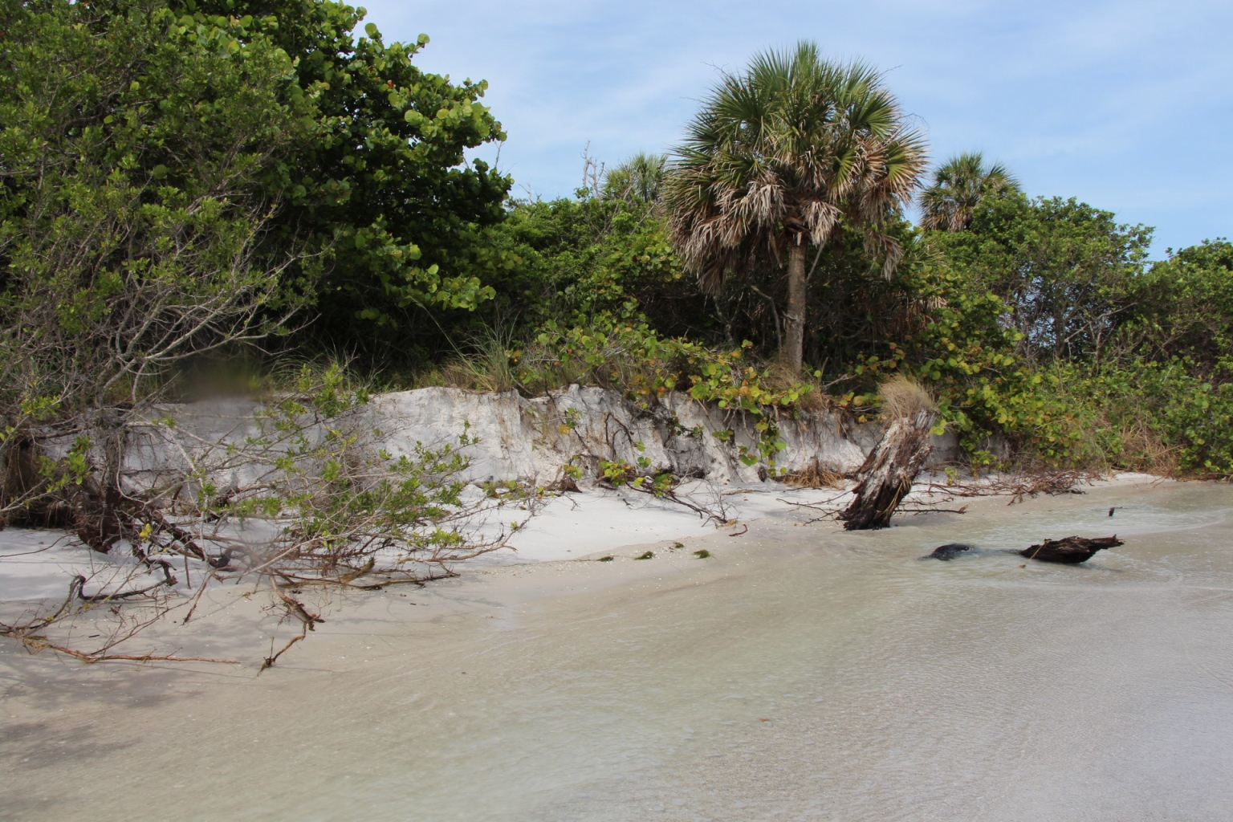
Photo credit: Dave Kandz
Sea level rise is already evident along Florida’s coastlines…

Slide 5
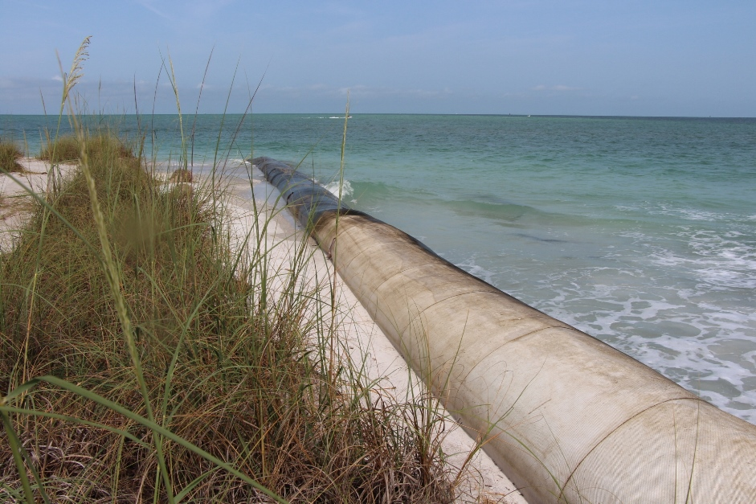
…and hardening our coastlines will not hold back the ocean indefinitely.
Photo: Dave Kandz
Notes:
Hardening, or armoring, our coastlines with structures such as these geotubes create narrow beaches or vertical berms along the coast that can’t be used by beach-nesting birds or sea turtles. As sea levels rise these expensive structures will have to be repaired or replaced frequently and hard structures will not hold back the ocean indefinitely.

Slide 6
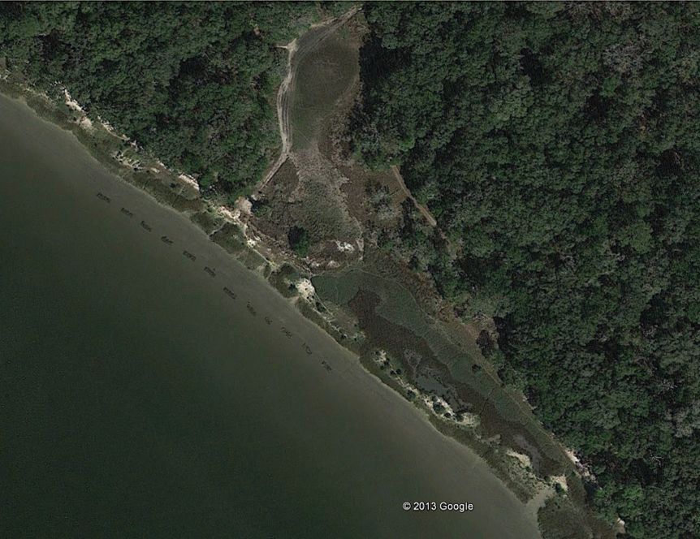
One promising method of managing saltmarsh erosion that has been used in northeast Florida is a living shoreline that protects the saltmarsh and allows it to rebuild naturally.
Alternative:
A “living shoreline” protects saltmarsh and allows it to rebuild naturally.
Notes:
One alternative to shoreline hardening in use in Northeast Florida is a living shoreline. Oyster shells, limestone rock, or other natural materials are placed along saltmarsh shorelines where oyster spat can take hold and build up a living structure that protects the shoreline from wave erosion. Living shorelines also trap sediment and maintain foraging and nesting habitat for birds.

Slide 7
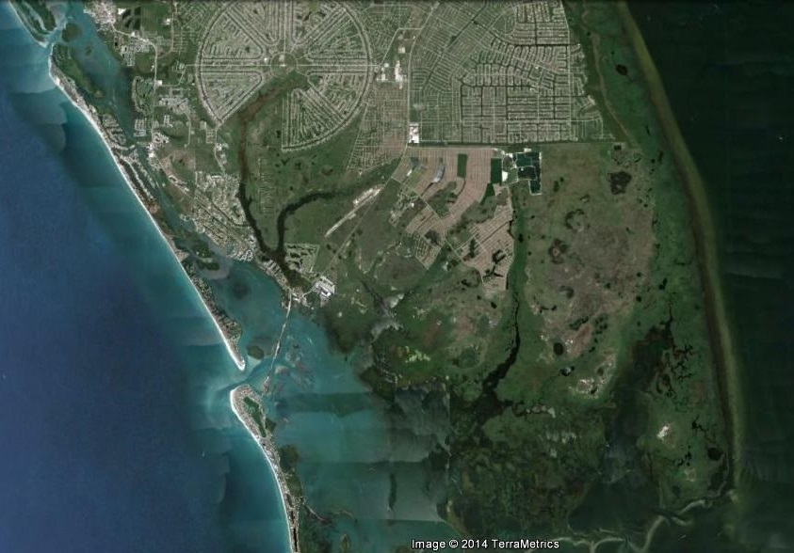
Alternative: allow beaches to migrate inland by preserving adjacent undeveloped uplands
Notes:
Another alternative to hardened shoreline structures is to purchase and protect undeveloped land adjacent to the coast that will provide pathways for coastal habitat and coastal wildlife to reestablish naturally farther inland. (This example is state-owned land on the west side of Charlotte Harbor.)

Slide 8
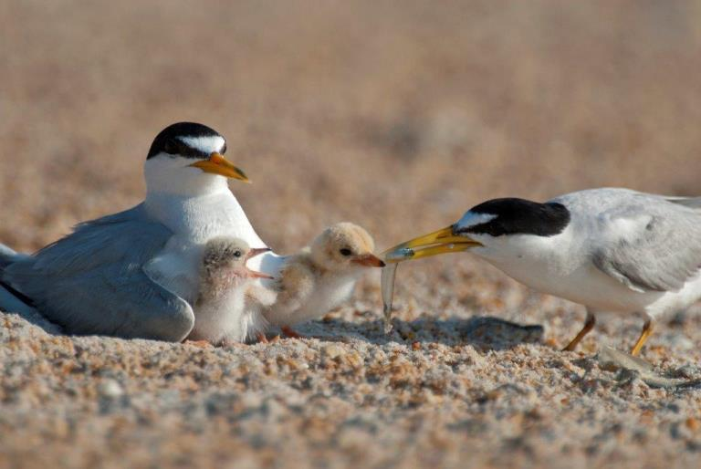
Learn more about birds and wildlife living in coastal areas and how to protect their habitat in the face of sea level rise.
Photo: David Macri
Notes:
We ask you to become knowledgeable about coastal birds and wildlife and work with us to find ways that will allow both wildlife and people to adapt to the inevitable reshaping of Florida’s coastline as sea levels rise.

Slide 9
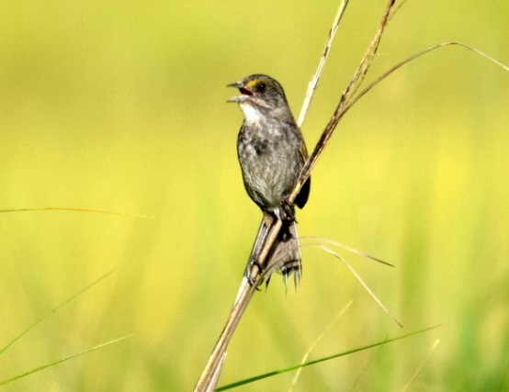
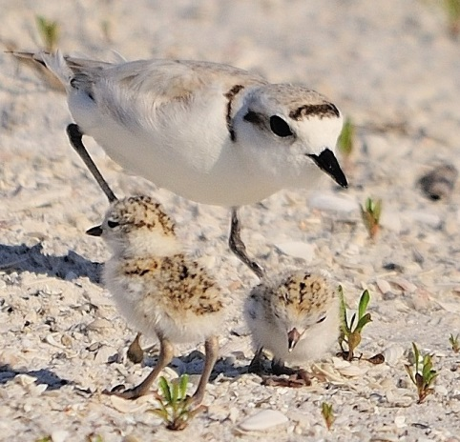
Photo: John Nelson
Photo: John Young
Let’s plan for climate change and make sure that our response to sea level rise helps – rather than harms – Florida’s beaches and coastlines.

Slide 10
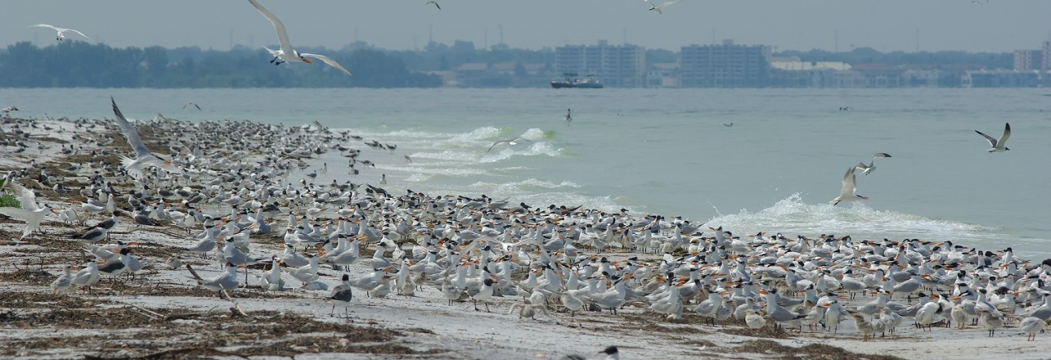
Learn more
about sea level rise and coastal habitat
FloridaClimateMessenger.com

